Slide 1


Presented by Monu Dhakad
Vulnerability
Report
Internship studio project
http://testasp.vulnweb.com/

Slide 2

Introduction
As per the task’s description, this slide will contain a screenshot of Invicti-found vulnerabilities (Note that Netsparker is now renamed as Invicti), screenshots of the report that Invicti generated, and a report that I’ve created so that you can check the difference between the actual and my submitted report

Slide 3
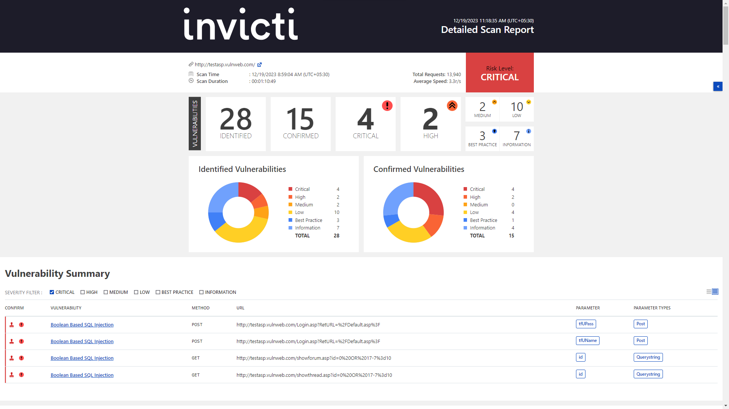

Slide 4
URL : http://testasp.vulnweb.com/showforum.asp?id=0%20OR%2017-7=10
Parameter Name : id
Parameter Type : GET
Attack Pattern : 0+OR+17-7%3d10
Vulnerability details
Invicti Standard identified a Boolean-Based SQL Injection, which occurs when data input by a user is interpreted as a SQL command rather than as
normal data by the backend database.
This is an extremely common vulnerability and its successful exploitation can have critical implications.
Invicti Standard confirmed the vulnerability by executing a test SQL query on the backend database. In these tests, SQL injection was not obvious, but the
different responses from the page based on the injection test allowed Invicti Standard to identify and confirm the SQL injection.
Impact
Depending on the backend database, the database connection settings, and the operating system, an attacker can mount one or more of the following
type of attacks successfully:
Reading, updating and deleting arbitrary data/tables from the database
Executing commands on the underlying operating system

Slide 5
Actions to Take
See the remedy for solution
If you are not using a database access layer (DAL), consider using one. This will help you centralize the issue. You can also use ORM (object
relational mapping). Most of the ORM systems use only parameterized queries and this can solve the whole SQL injection problem
Locate all of the dynamically generated SQL queries and convert them to parameterized queries. (If you decide to use a DAL/ORM, change all
legacy code to use these new libraries.)
Use your weblogs and application logs to see if there were any previous but undetected attacks to this resource
Remedy
The best way to protect your code against SQL injections is using parameterized queries (prepared statements). Almost all modern languages provide built-in
libraries for this. Wherever possible, do not create dynamic SQL queries or SQL queries with string concatenation.
Required Skills for Successful Exploitation
There are numerous freely available tools to exploit SQL injection vulnerabilities. This is a complex area with many dependencies; however, it should be
noted that the numerous resources available in this area have raised both attacker awareness of the issues and their ability to discover and leverage them.
External References
OWASP SQL injection
SQL Injection Cheat Sheet
SQL Injection Vulnerability
Remedy References
A guide to preventing SQL injection
SQL injection Prevention Cheat Sheet

Slide 6
My Report
summary:
The website has an endpoint that is vulnerable to an injection vulnerability named - Boolean-Based SQL injection (a type of SQL Injection), where the attacker
sends SQL queries to the database, forcing the application to return a different result depending on whether the query returns a true or false result.
This is a very common and critical vulnerability that can cause a very serious impact.
So, I ran this test where I tried a SQL query on the database behind the scenes. At first, I didn't see any obvious SQL injection, but the way the page responded
during my test helped me spot and confirm the SQL injection vulnerability.
Required Skills for Successful Exploitation
tons of free tools floating around help people exploit these weaknesses in a system. It's not an easy deal, however. There's a lot to it, nut any attackers know how
to deal with them
the thing is that several tools have made it easier for attackers to get a grip on these problems They're more aware of the issues now, and they've gotten better
at spotting and using these vulnerabilities.
the more these tools are out there, the more the bad guys know about these gaps, and the more they can exploit them.
Impact
depending on what kind of database is in the background, how it's connected, and what operating system is running, any person could do a few different
types of attacks that might work:
They could read, change, or even delete any data or tables they want from the database.
They might even be able to run commands on the actual operating system that's running everything. Like, they could make the system do things
it shouldn't, just by exploiting these weaknesses.

Slide 7
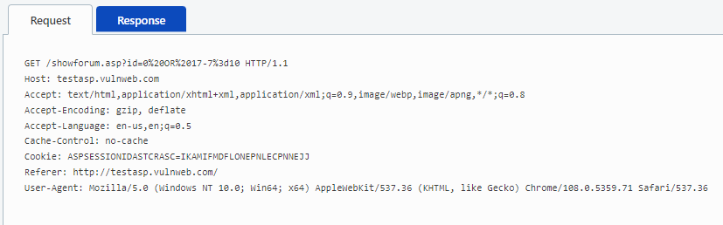
Actions to Take
if you're not already using a database access layer (DAL), you should get one. It's like a way to centralize stuff and keep things in line.
Another cool thing to check out is ORM (object-relational mapping). With ORM, it's mostly about using parameterized queries, which can fix up the whole SQL
injection mess. It's like a built-in way to keep things safe and sorted when you're working with databases.
Find all those SQL queries that are dynamically generated, and switch those up to use parameterized queries instead. If you decide to go with a database
access layer (DAL) or an object-relational mapping (ORM) thing, make sure to update all the old code to use these new libraries. It's like giving your system
an upgrade to keep things secure.
Check out your web and app logs to see if there were any attacks on this resource before that went unnoticed. Sometimes, those logs hold clues
about stuff that happened but wasn't picked up at the time.
Vulnerabilities
http://testasp.vulnweb.com/showforum.asp?id=0%20OR%2017-7%3d10

Slide 8
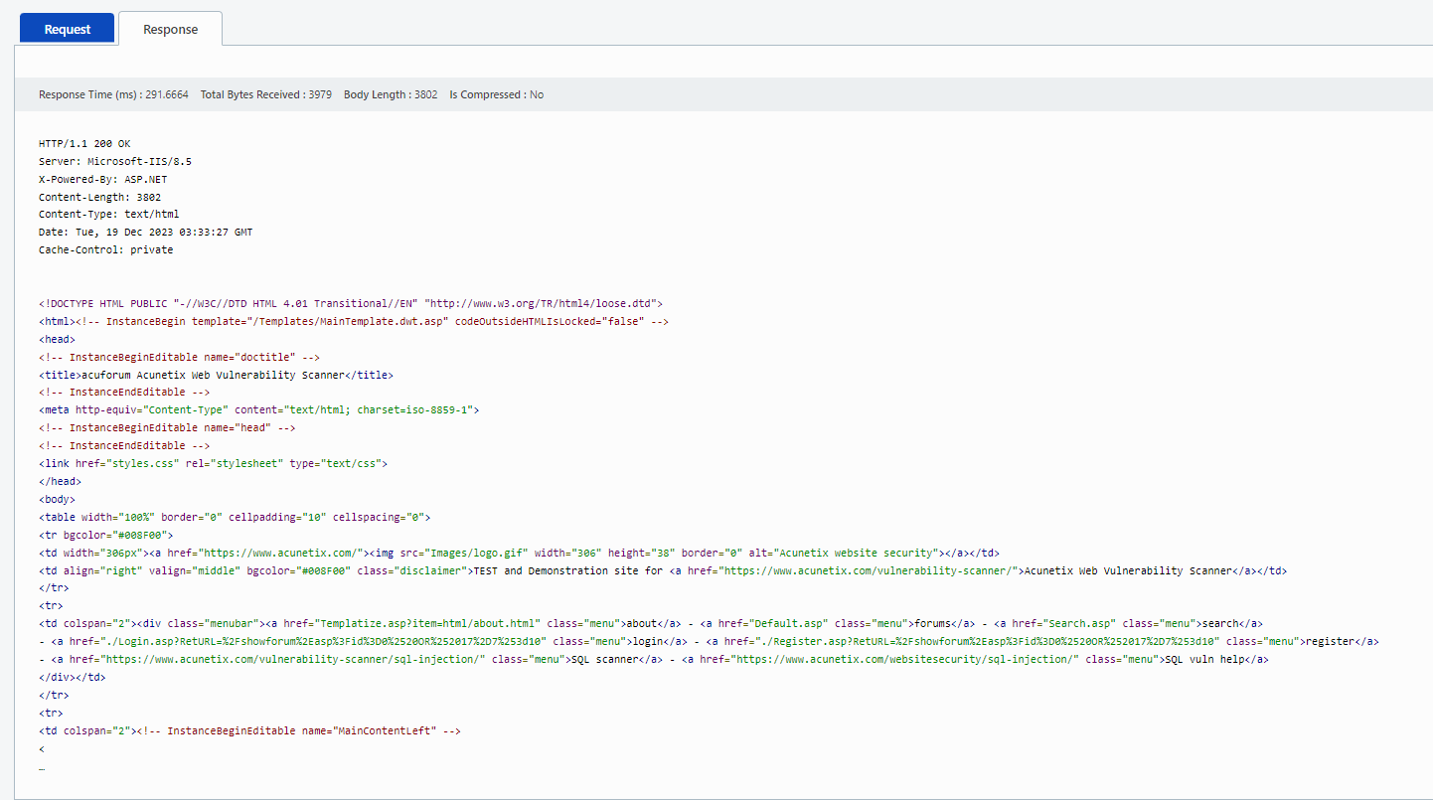

Slide 9
Remedy
To keep your code safe from SQL injections, the go-to move is using parameterized queries, also known as prepared statements. Most new languages have
their own ready-made libraries for this security trick. Try to avoid making dynamic SQL queries or joining strings to form SQL queries whenever you can.
External References
OWASP SQL injection
SQL Injection Cheat Sheet
SQL Injection Vulnerability
Remedy References
A guide to preventing SQL injection
SQL injection Prevention Cheat Sheet

Slide 10

Presented by Monu Dhakad
Thank you very much!
monudhakad2332005@gmail.com

